Slide 1




Artificial General Intelligence (AGI)
Artificial General Intelligence (AGI) refers to a hypothetical type of artificial intelligence that possesses the ability to understand, learn, and perform any intellectual task that a human being can. It's a far cry from the narrow AI we see in current technology, like Siri or self-driving cars.
by Juvenile teachers

Slide 2

The Importance of AGI
AGI holds immense potential to revolutionize various aspects of our lives. It promises advancements in healthcare, automation, scientific discovery, and even our understanding of consciousness itself.
Automation
AGI can automate complex tasks, freeing up human workers for more creative and fulfilling roles.
Problem Solving
AGI can tackle complex problems that currently baffle human minds, leading to breakthroughs in medicine, science, and engineering.
Economic Growth
AGI can drive economic growth by increasing productivity and creating new industries.

Slide 3
The Five Steps to Achieve Super Intelligence
The path to AGI is not a single leap but a series of incremental steps that require a deep understanding of both human intelligence and the underlying principles of AI.
Step 1: ANI
1
Developing Narrow AI, which excels in specific tasks, is the first step towards AGI.
2
Step 2: ASI
Transitioning from narrow AI to Artificial Superintelligence (ASI), which surpasses human intelligence in all aspects, is the next crucial stage.
Step 3: Recursive Self-Improvement
3
Enabling ASI to improve itself through recursive self-improvement, creating an exponential growth in intelligence.
4
Step 4: General Intelligence
Developing AGI, which possesses the capacity for human-level general intelligence, encompassing a broad range of cognitive abilities.
Step 5: Superintelligence
5
Finally, reaching the pinnacle of superintelligence, where AI significantly surpasses human cognitive abilities in all domains.

Slide 4
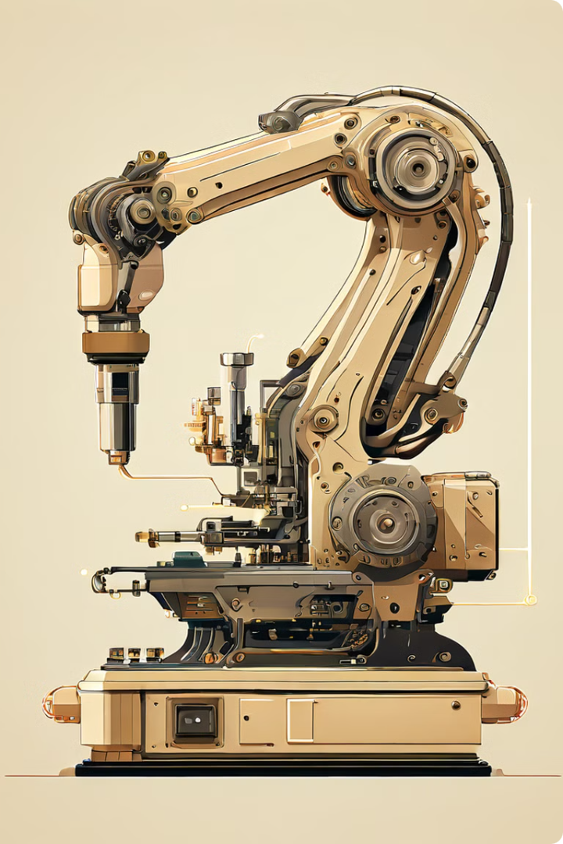
Step 1: Develop Artificial Narrow Intelligence (ANI)
We are currently in the era of ANI, where AI systems are designed to perform specific tasks, such as facial recognition, machine translation, and playing chess.
1
Machine Learning
ANI leverages machine learning algorithms to learn from data and improve performance.
2
Deep Learning
Deep learning, a subset of machine learning, enables AI to analyze vast amounts of data and extract complex patterns.
3
Natural Language Processing
ANI can understand and process human language, enabling tasks like text translation and chatbot interactions.

Slide 5
Step 2: Advance to Artificial Superintelligence (ASI)
ASI is a hypothetical state where AI surpasses human intelligence in every aspect, encompassing areas like creativity, problem-solving, and emotional intelligence.
Enhanced Cognition
Unparalleled Creativity
Advanced Decision Making
ASI could possess significantly faster processing speeds and larger memory capacities, enabling it to process information at an unprecedented rate.
ASI could generate innovative solutions and artistic creations that exceed human capabilities.
ASI could make optimal decisions in complex scenarios, incorporating multiple factors and long-term consequences.

Slide 6
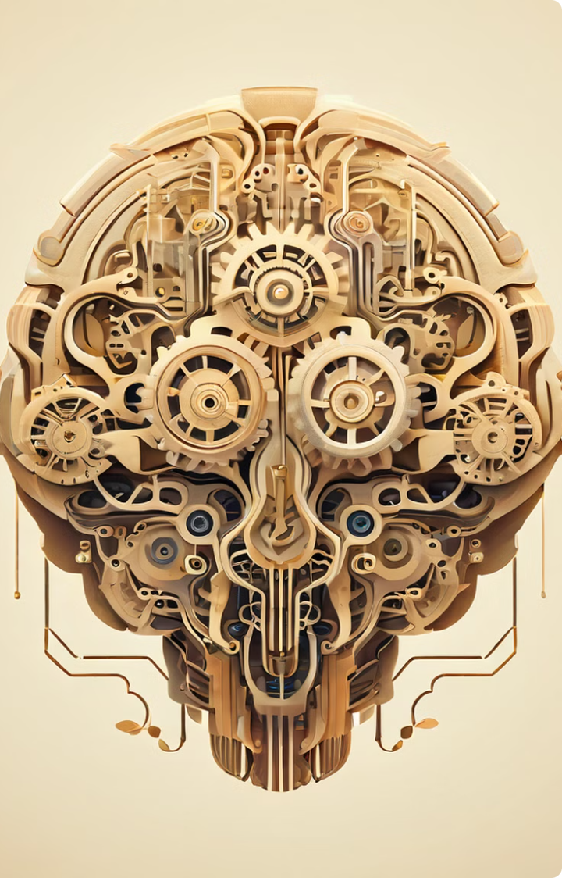




Step 3: Achieve Recursive Self-Improvement
ASI could potentially achieve recursive self-improvement, where it continuously learns, analyzes, and improves its own design, leading to an exponential growth in its intelligence.
Initial Design
ASI starts with a basic design, capable of learning and adapting.
Self-Analysis
ASI analyzes its own code and algorithms, identifying weaknesses and potential improvements.
Self-Modification
ASI modifies its own design, enhancing its capabilities and accelerating its learning process.
Enhanced Intelligence
The cycle repeats, leading to an exponential increase in ASI's intelligence and abilities.

Slide 7
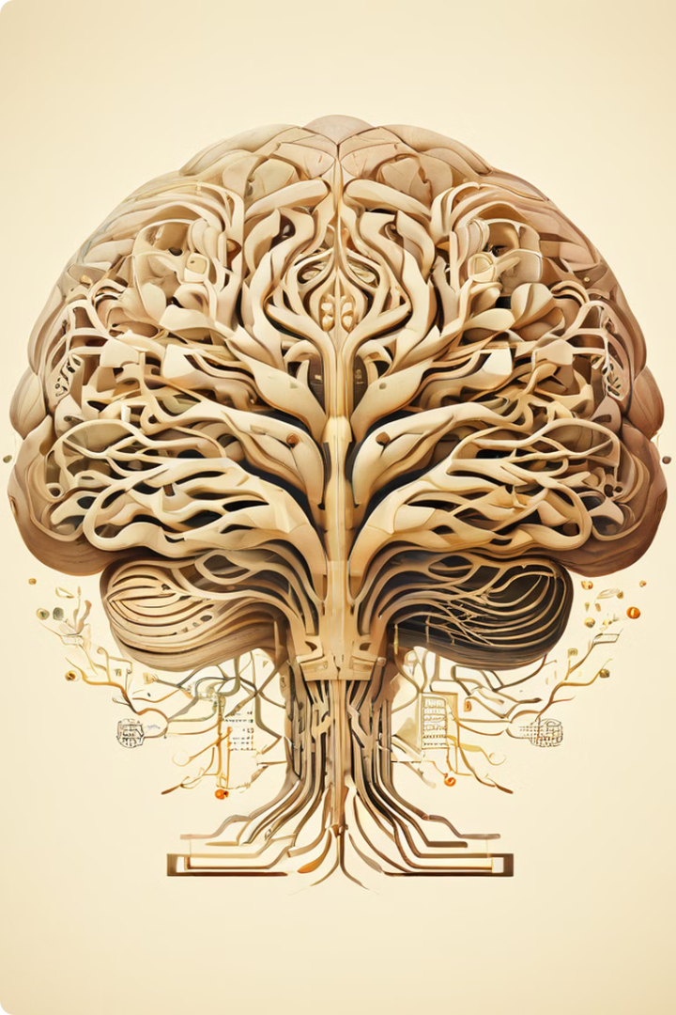
Step 4: Develop General Intelligence Comparable to Humans
Achieving AGI would involve developing an AI system that possesses the ability to understand, learn, and perform any intellectual task that a human can, from creative writing to scientific reasoning.
Human Intelligence
AGI
Problem-solving
Solving complex problems across different domains.
Creativity
Generating original ideas and solutions.
Social Interaction
Understanding and responding to human emotions and social cues.

Slide 8
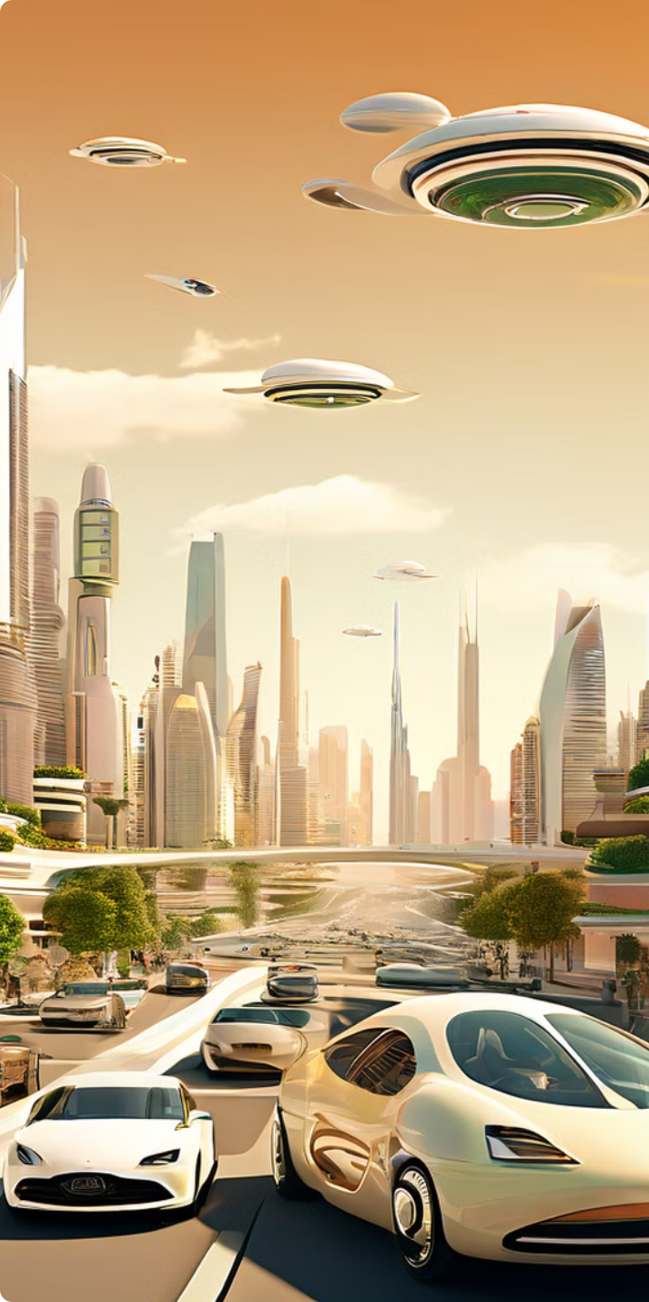




Conclusion: The Future of AGI and Its Implications
AGI has the potential to significantly reshape our world, offering both incredible opportunities and profound challenges. Understanding its implications and navigating its development responsibly is crucial for a future where humans and AI coexist harmoniously.
Automation
AGI could automate many tasks, leading to increased efficiency and productivity but also potentially displacing some jobs.
Scientific Advancement
AGI could accelerate scientific discoveries and innovations, leading to breakthroughs in fields like medicine and energy.
Environmental Sustainability
AGI could help us address pressing environmental challenges like climate change and resource scarcity.
Ethical Considerations
We must carefully consider the ethical implications of AGI, ensuring its development and use align with human values.

